Slide 1

Moneylog
Bing Bai
Li Yu
Lei Wang

Slide 2
ABOUT MONEYLOG
MoneyLog is a desktop application aiming to providing you an easy look on your daily spendings. The hassle-free entry interface will save your time and energy. Only taking 3 minutes a day on the application, you will have a clear understanding about your financial health. We are here to help you achieve your long-term financial goals.

Slide 3



Major functions
Expenses management
Cards management
Dashboard view
Adding each daily expense with easy-to-use entry interface
A desktop wallet managing all your credit and debit cards
Minimalist view and easy to read

Slide 4
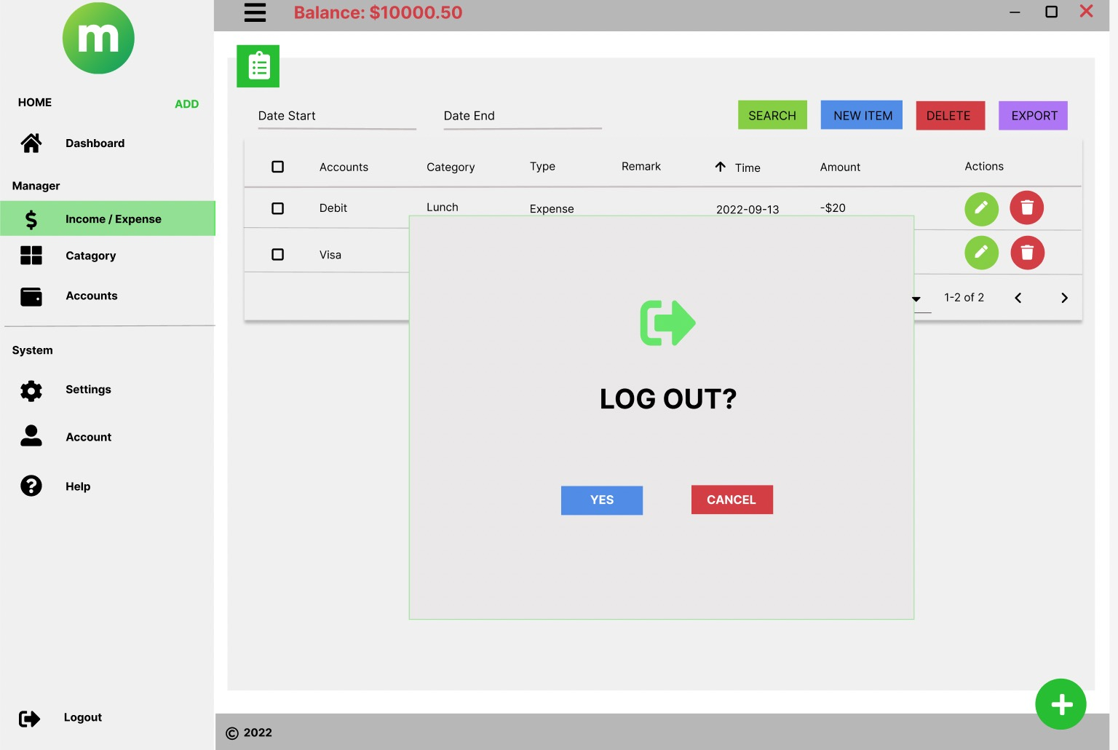
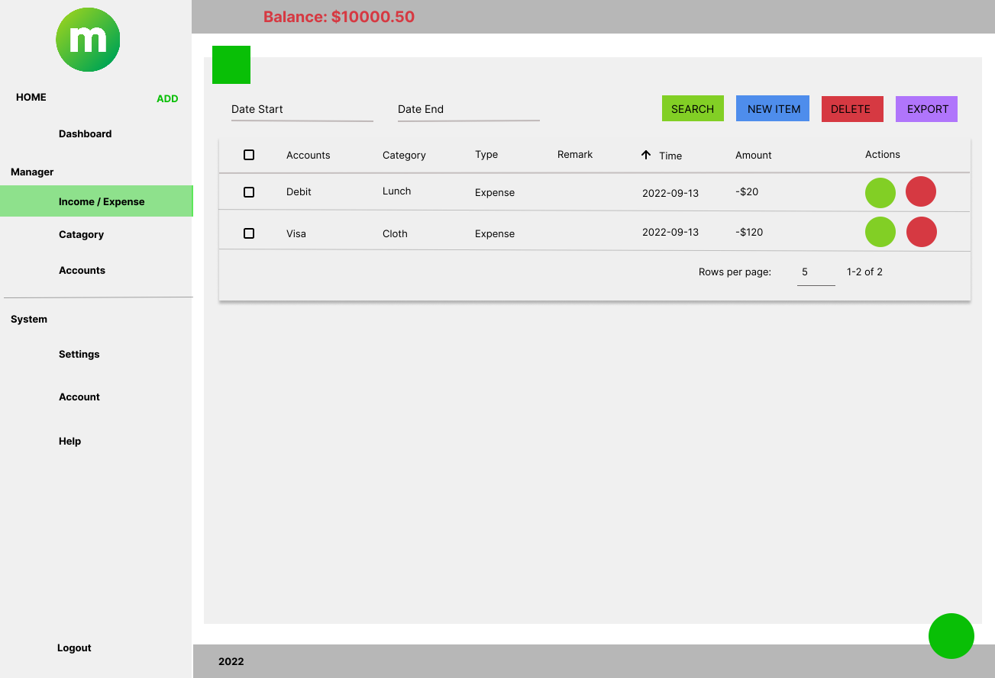
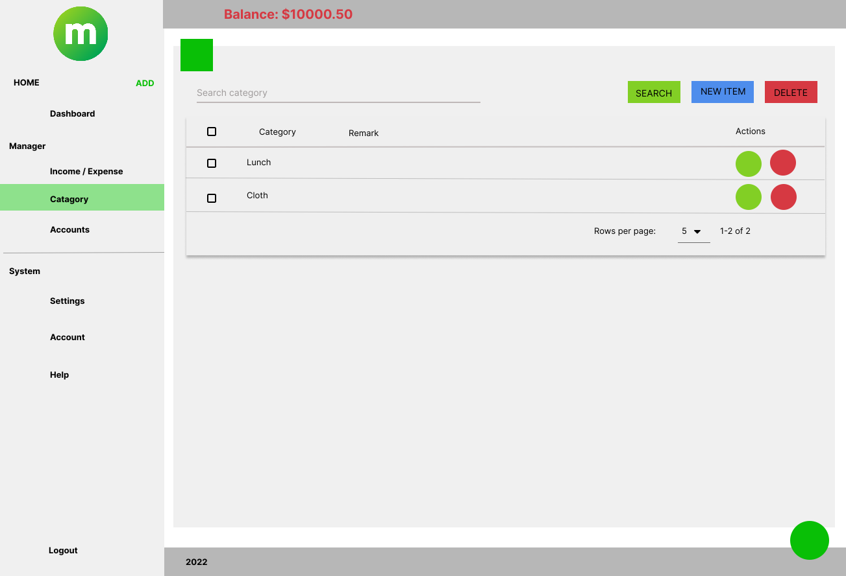
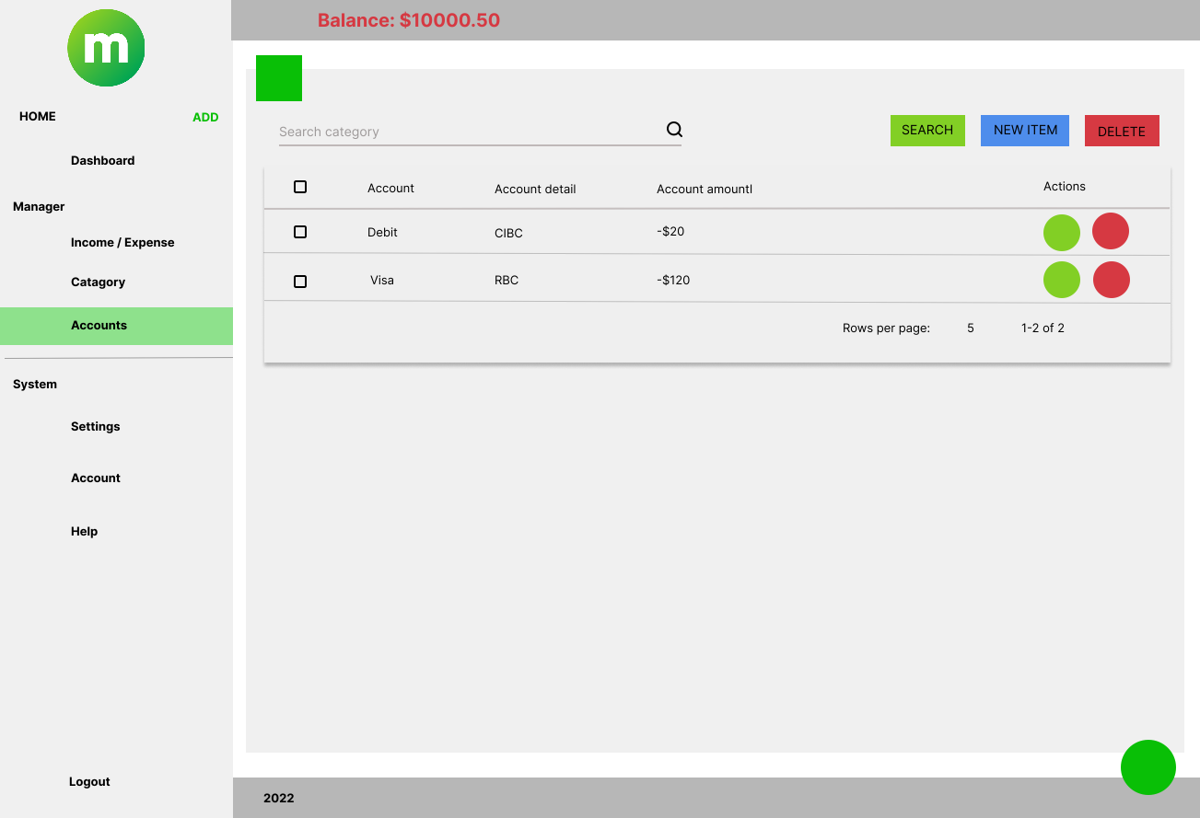


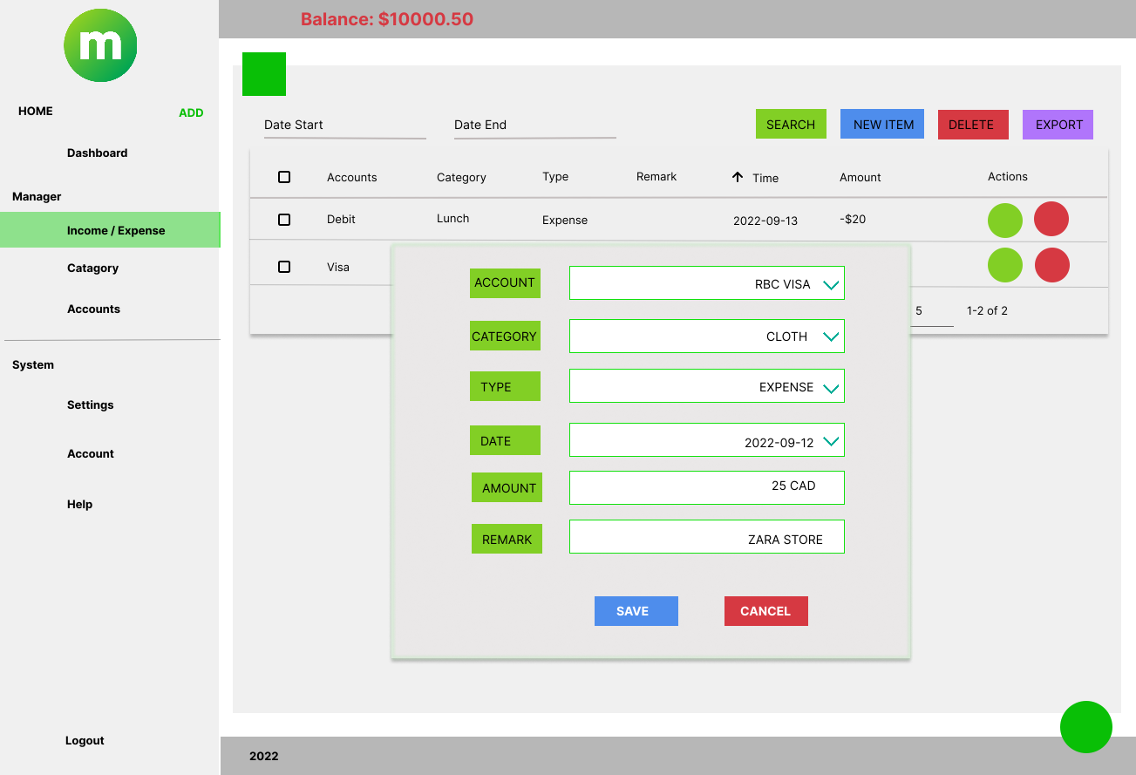
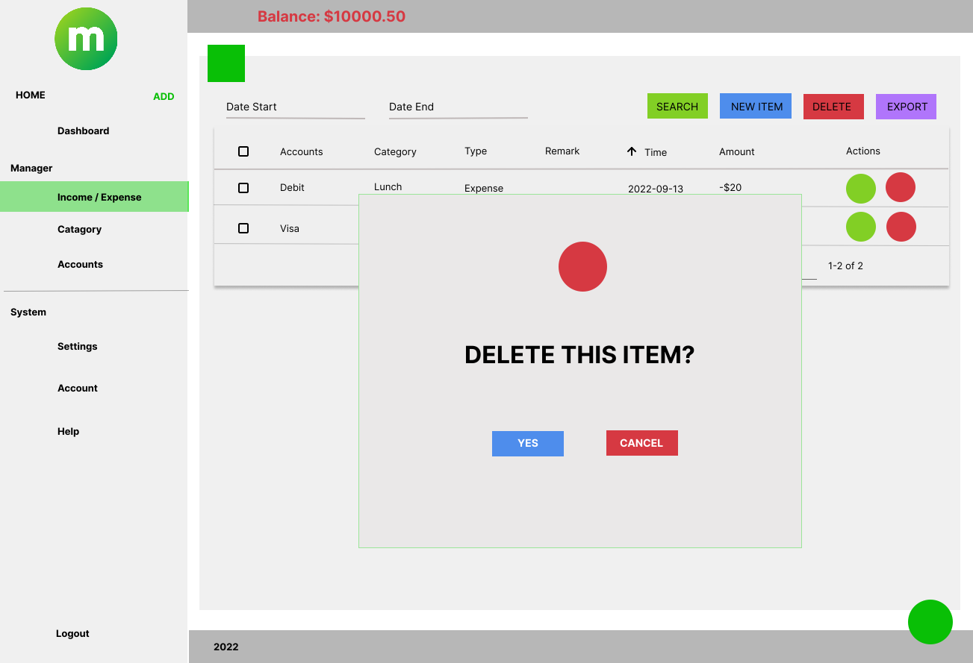
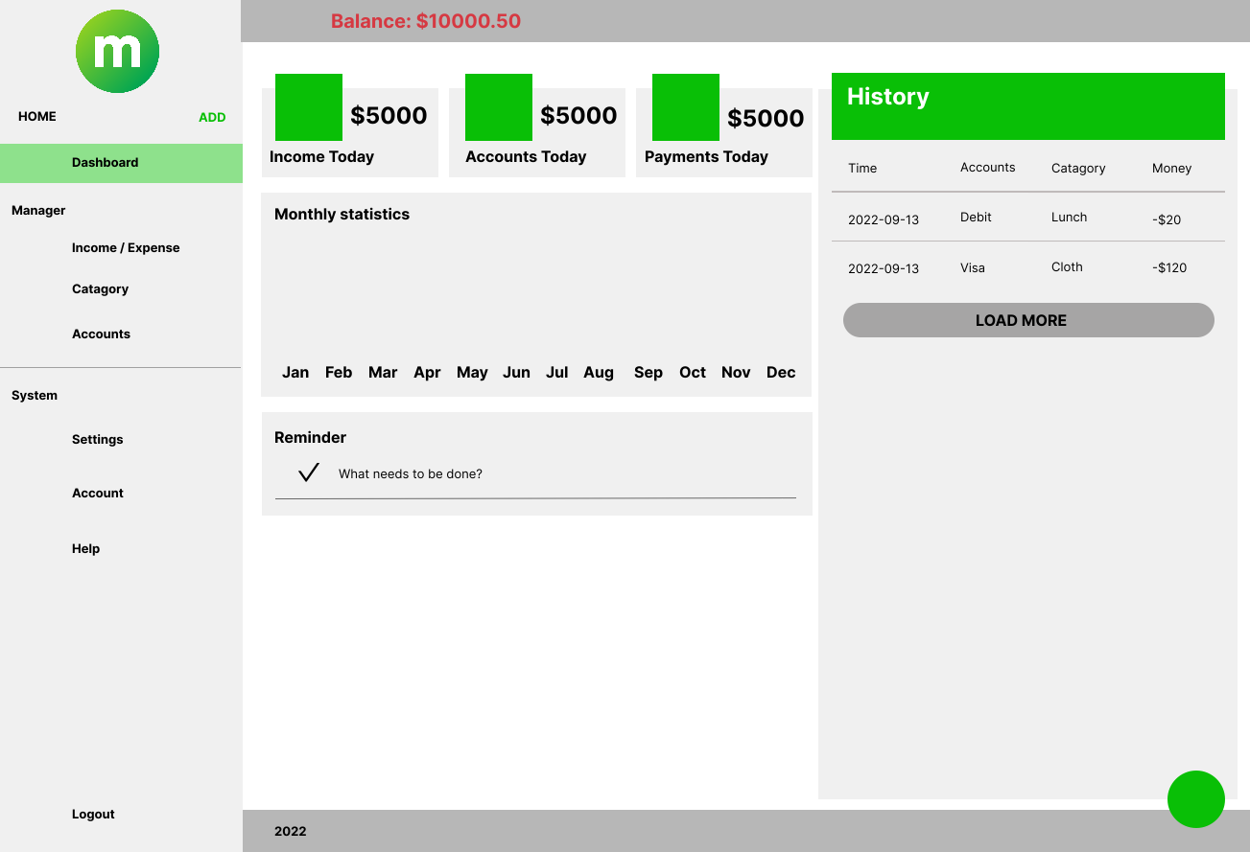
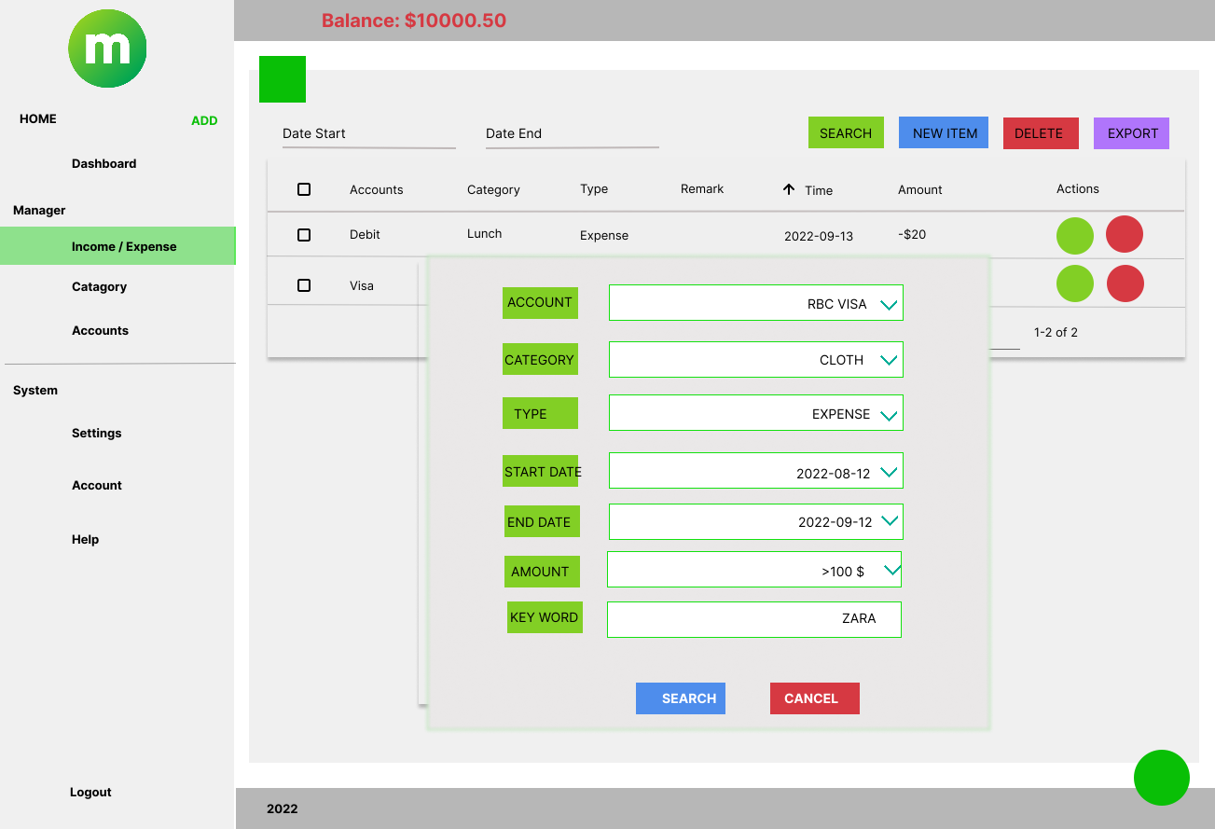
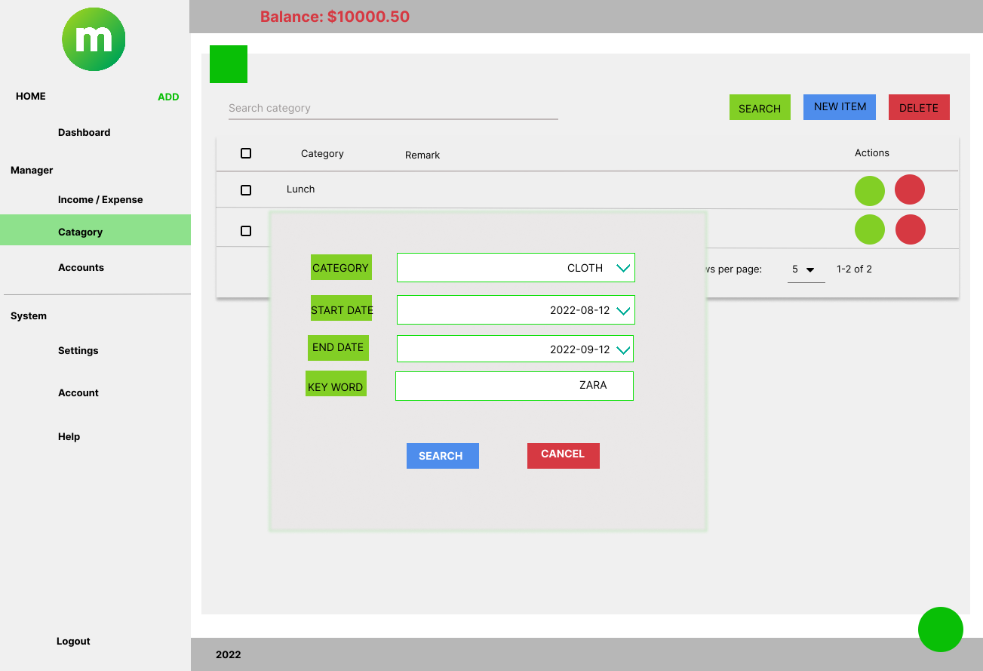
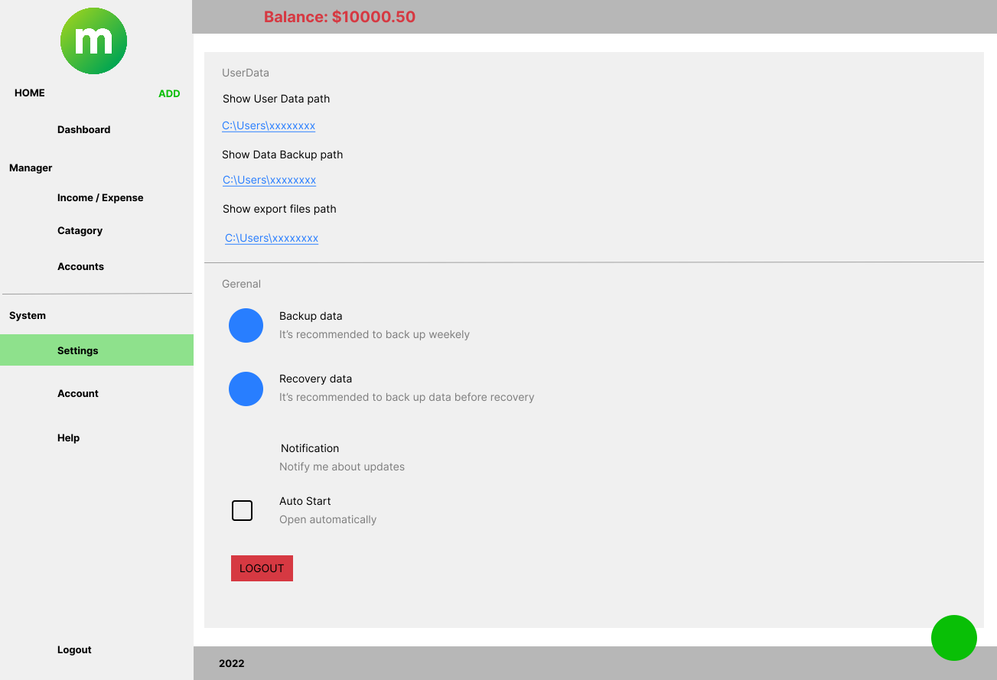
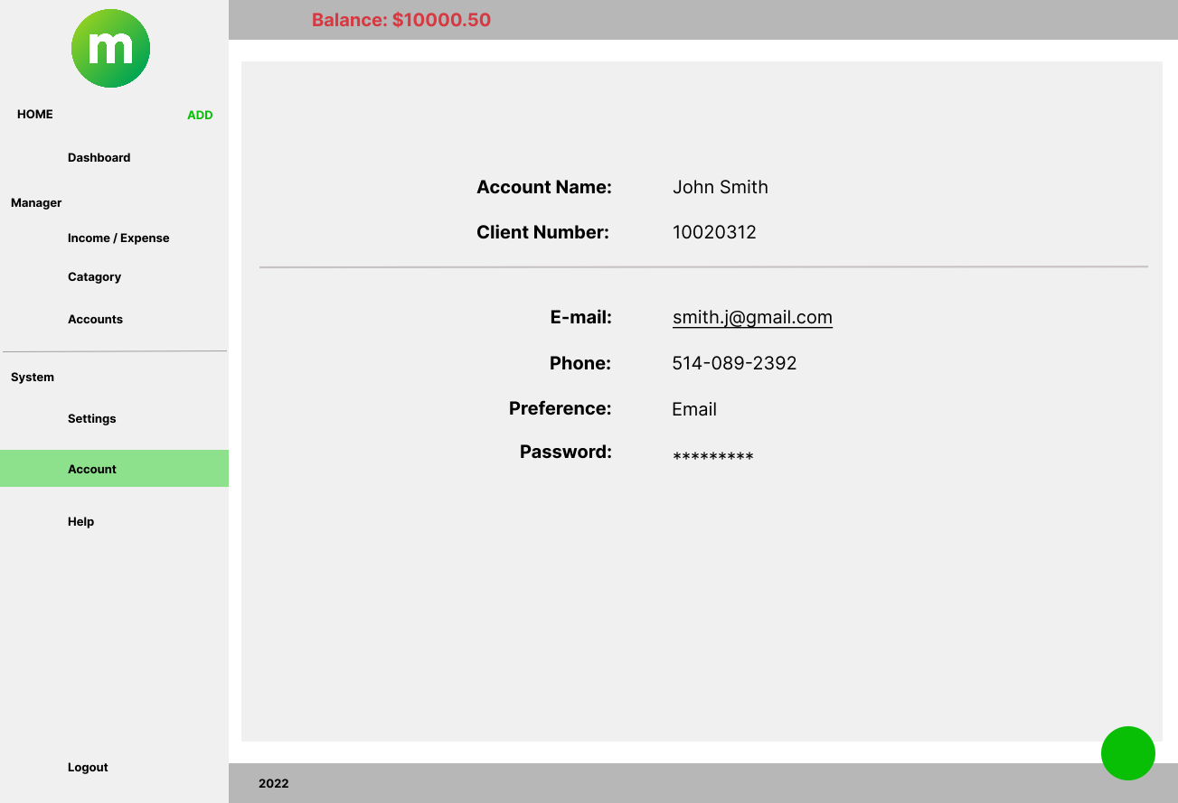
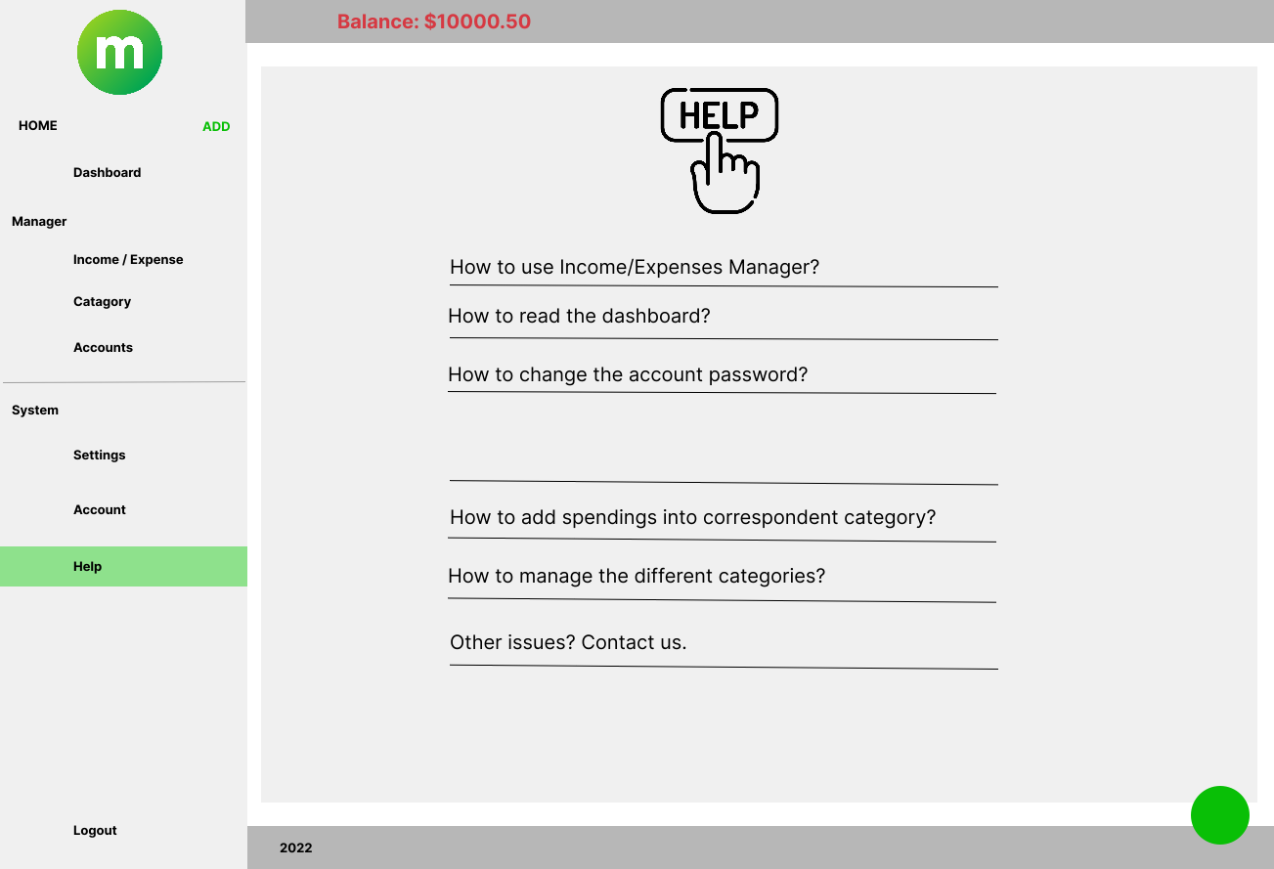
screen flows -21 screens
Manager
LOG OUT
Income/Expense
Category
Account
Adding
Delete
Adding
Delete
Adding
Delete
LOG IN
Dashboard
Search
Editing
Search
Editing
Editing
Sign up
System
Settings
Account
Help

Slide 5

Chosen database
UNIQUE
Reliability
open source, reliable, compatible with all major hosting providers, cost-effective, and easy to manage.
Efficiency
MySQL is exceptionally quick, regardless of the underlying platform.

Slide 6
Github link
https://github.com/binguniverseca/MoneyLog

Slide 7
Application mock-up

Slide 8
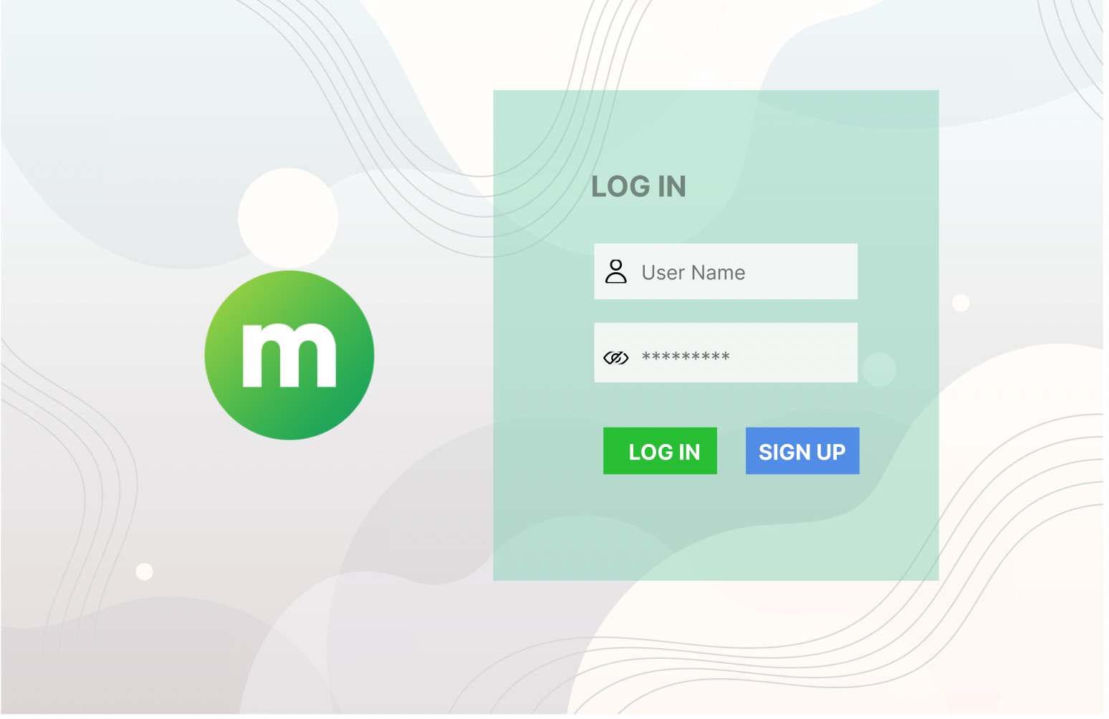


Log in

Slide 9
Sign up

Slide 10
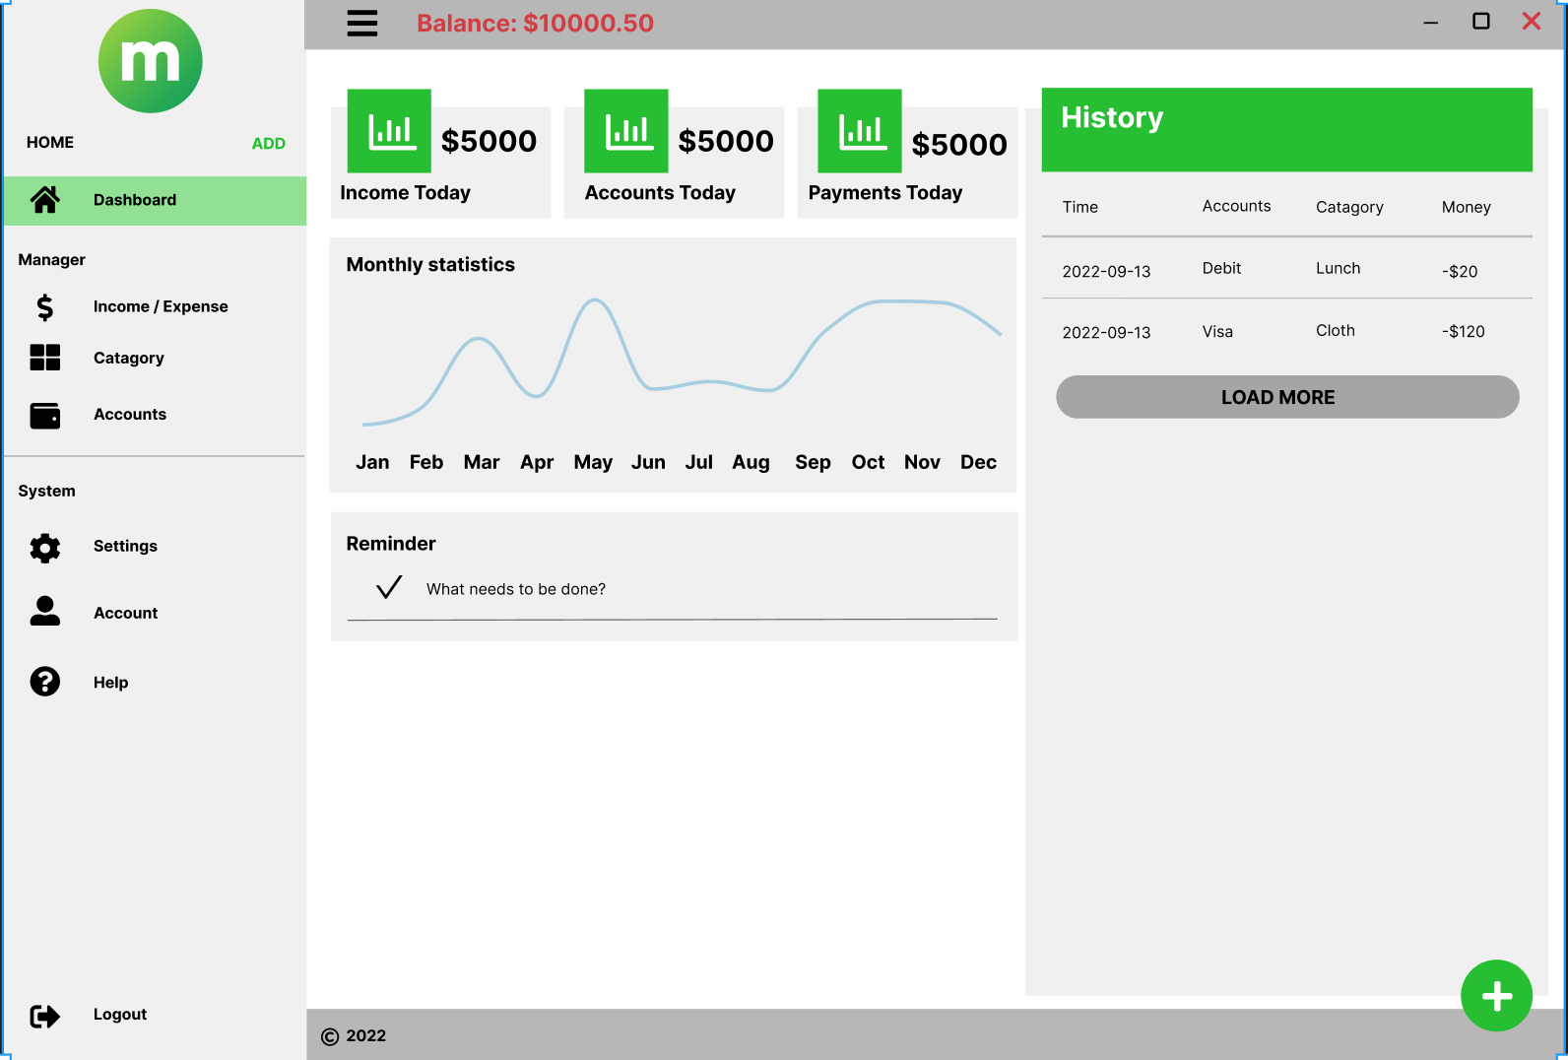
dashboard

Slide 11
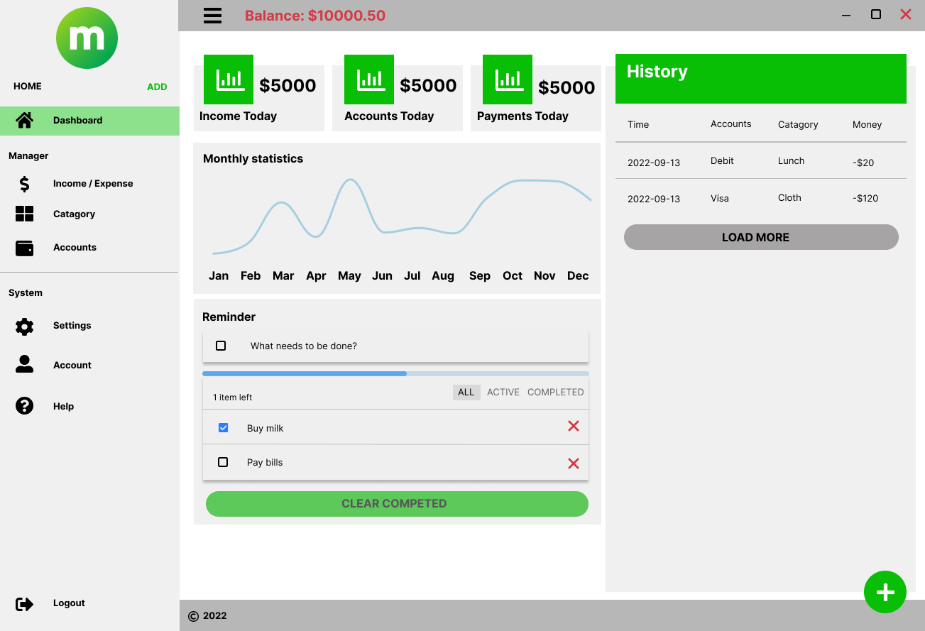
Dashboard-reminder

Slide 12
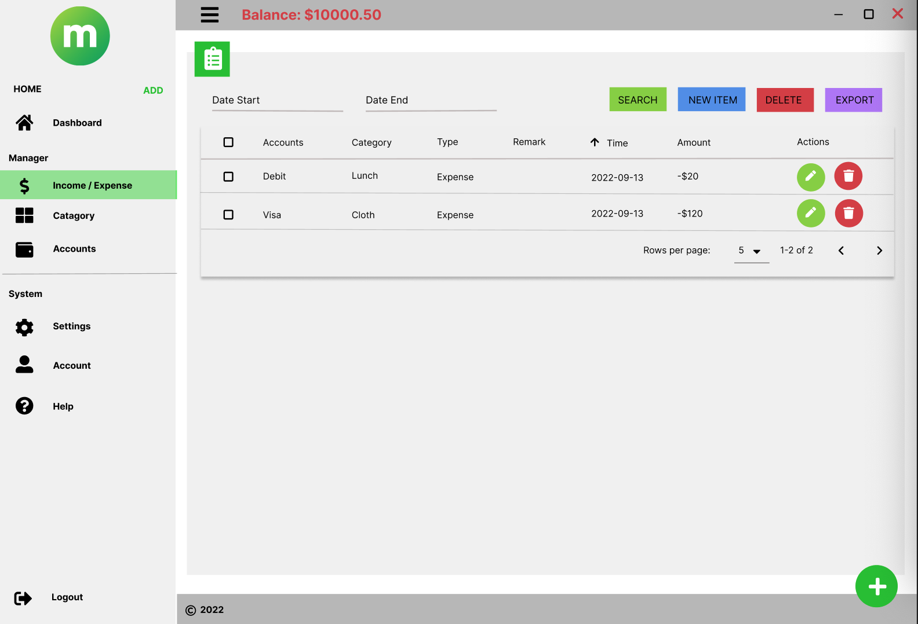
Manager– income/expense

Slide 13
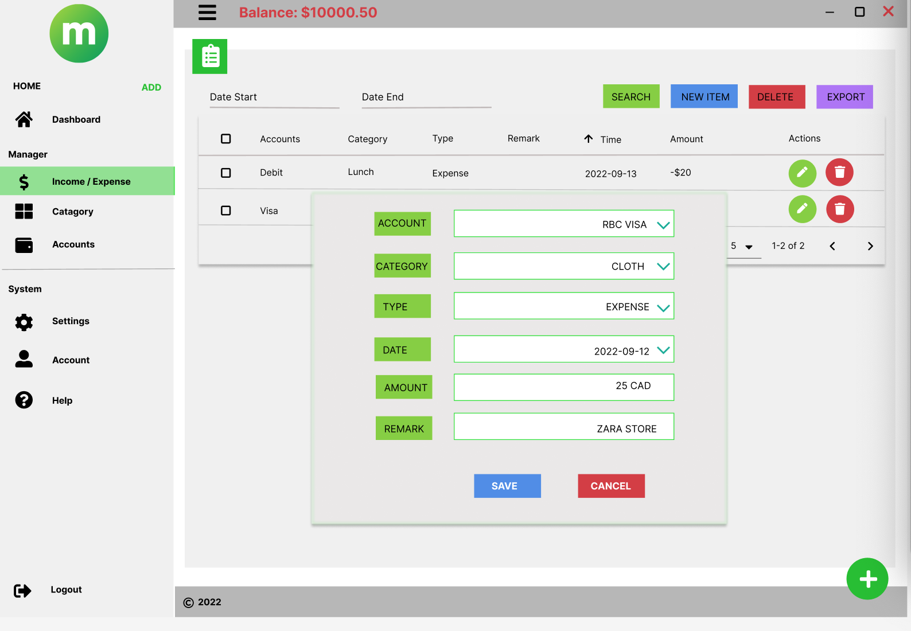
Manager– income/expense – adding new item

Slide 14
Manager– income/expense – Edit item

Slide 15
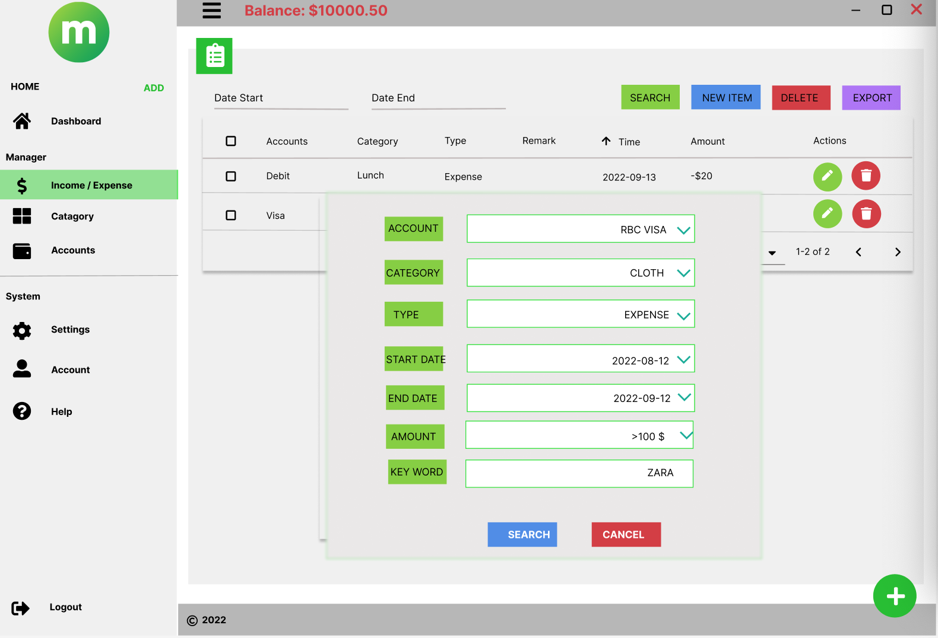
Manager– income/expense – search item

Slide 16
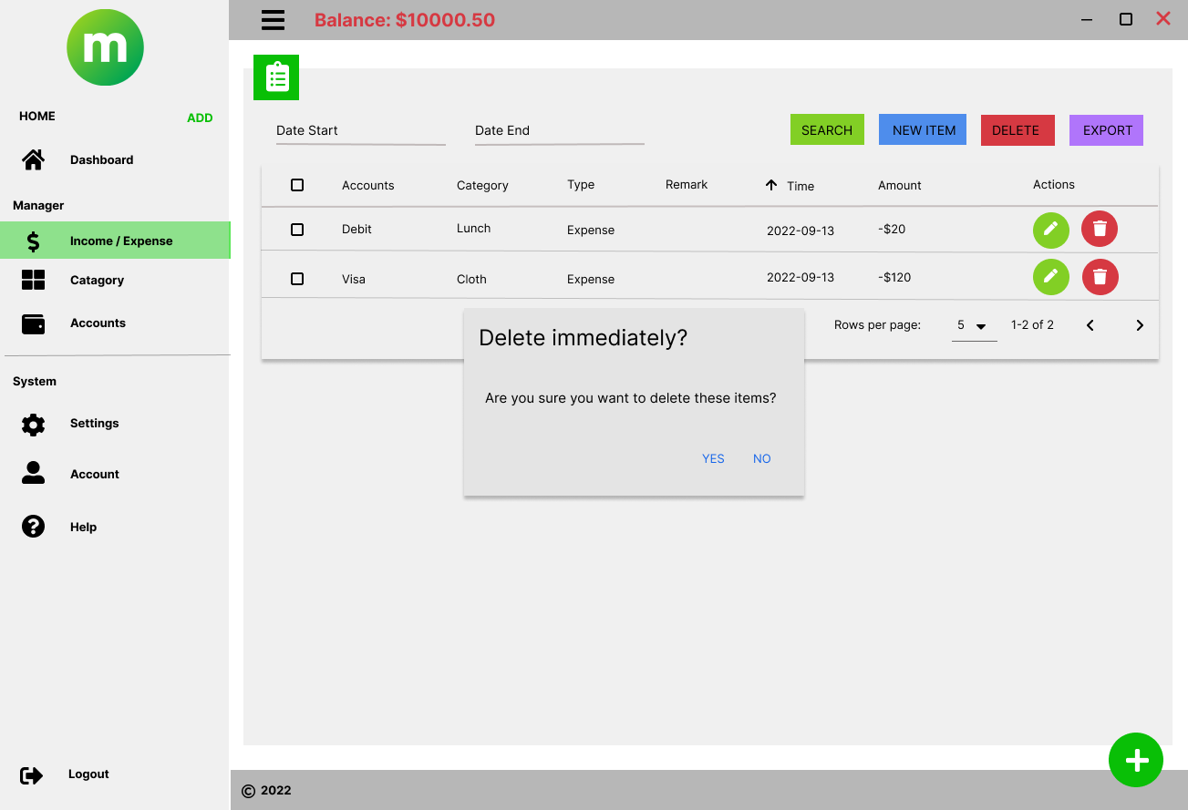
Manager– income/expense – delete item

Slide 17
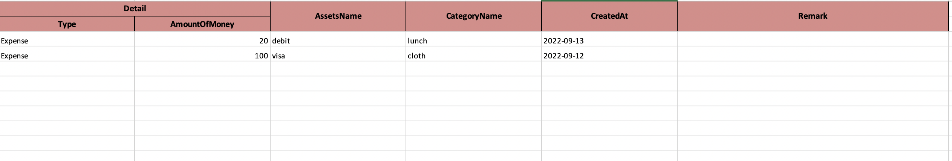
Manager– income/expense – export

Slide 18
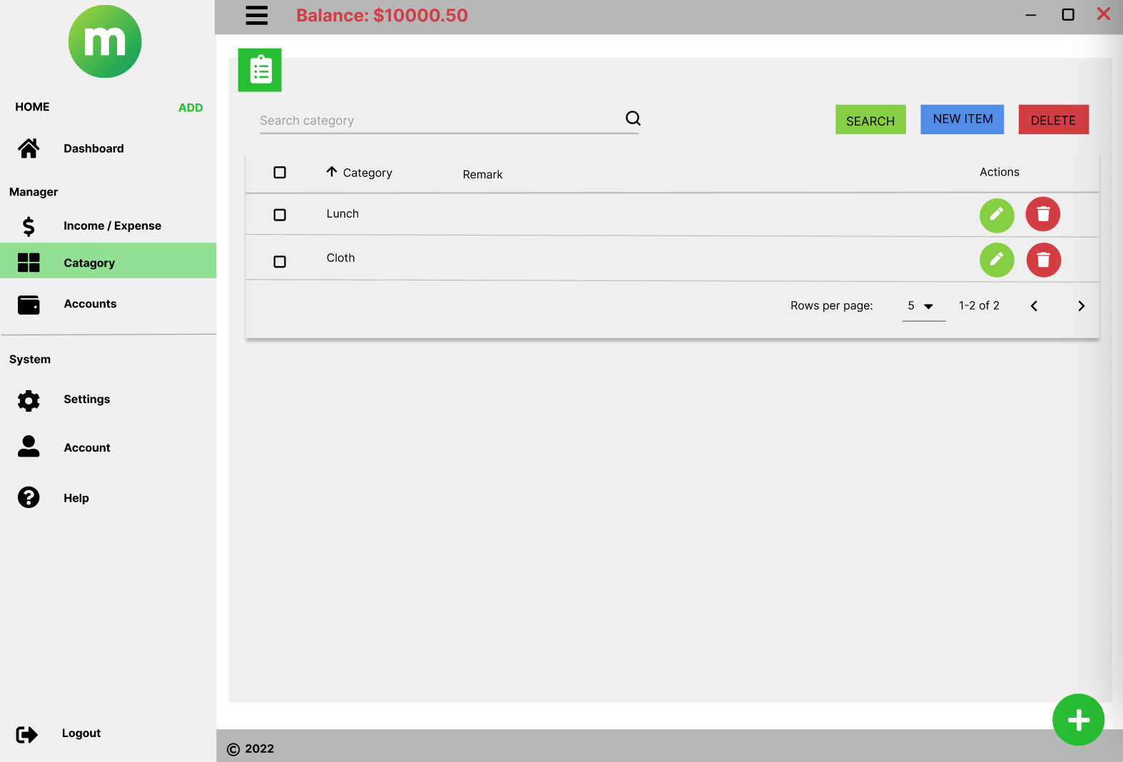
Manager - category

Slide 19
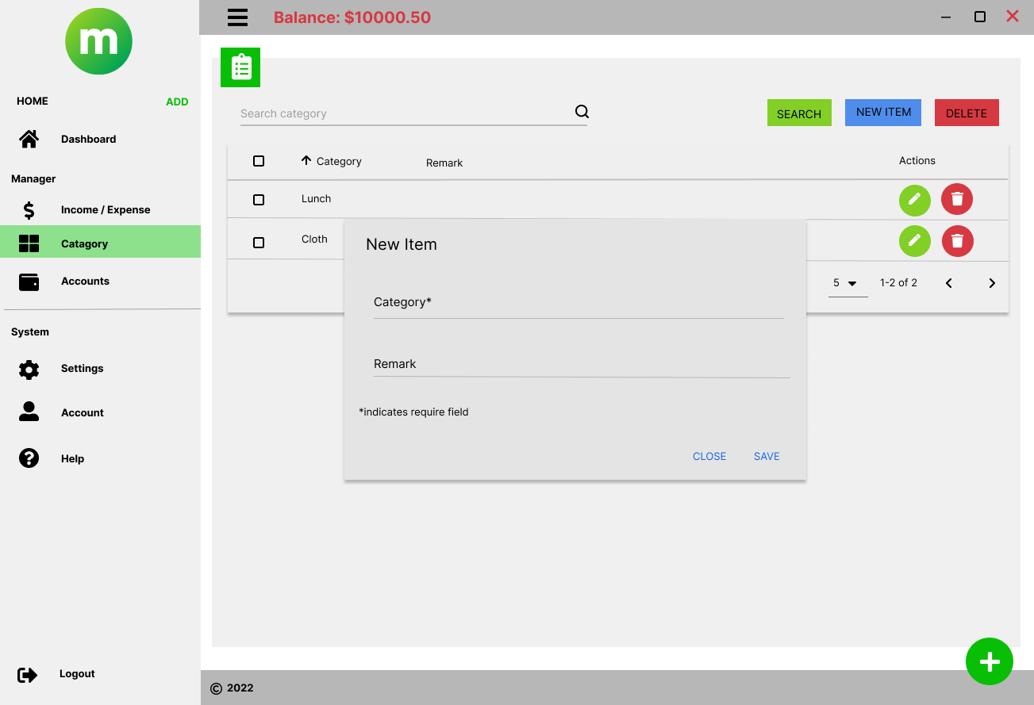
Manager – category – adding new category

Slide 20
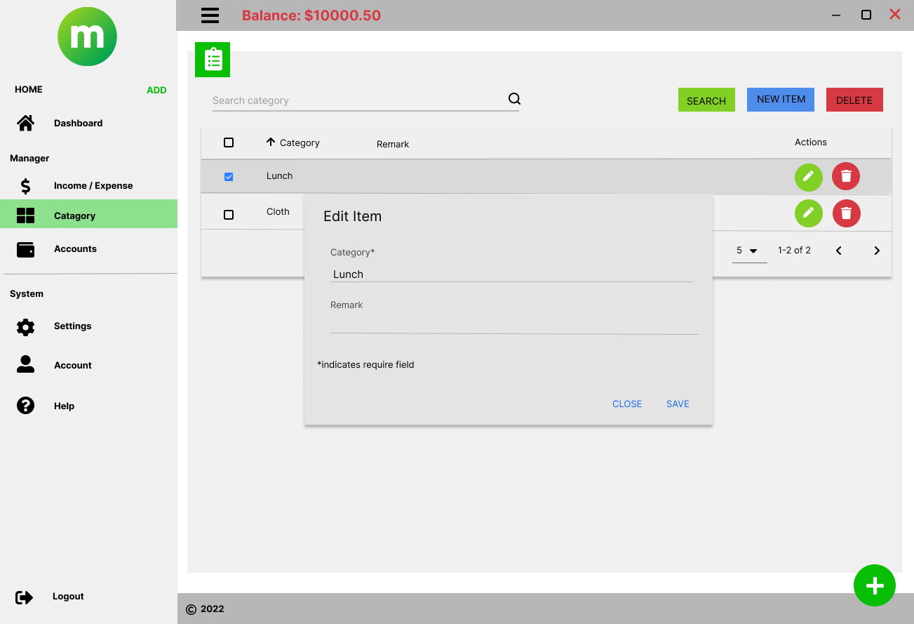
Manager – category – editing new category

Slide 21
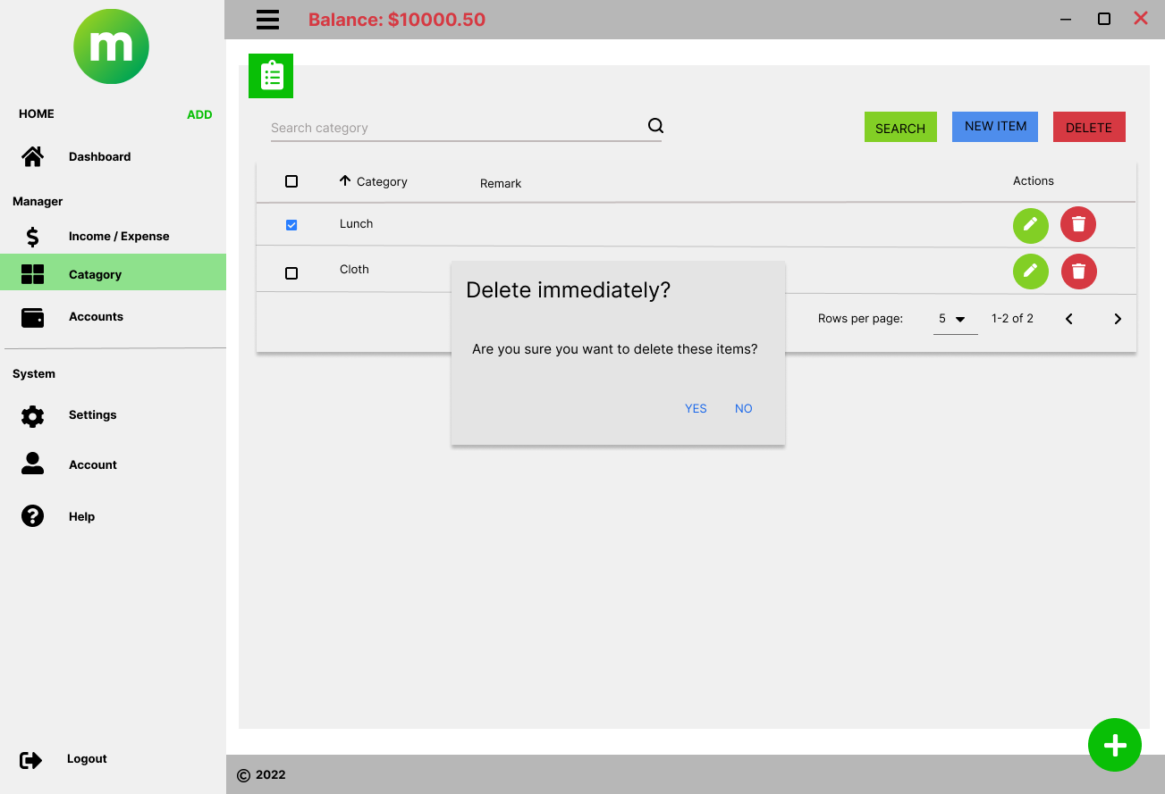
Manager – category -delete

Slide 22
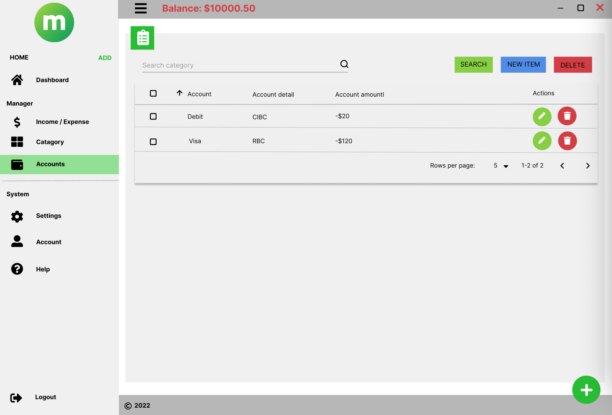
Manager - accounts

Slide 23
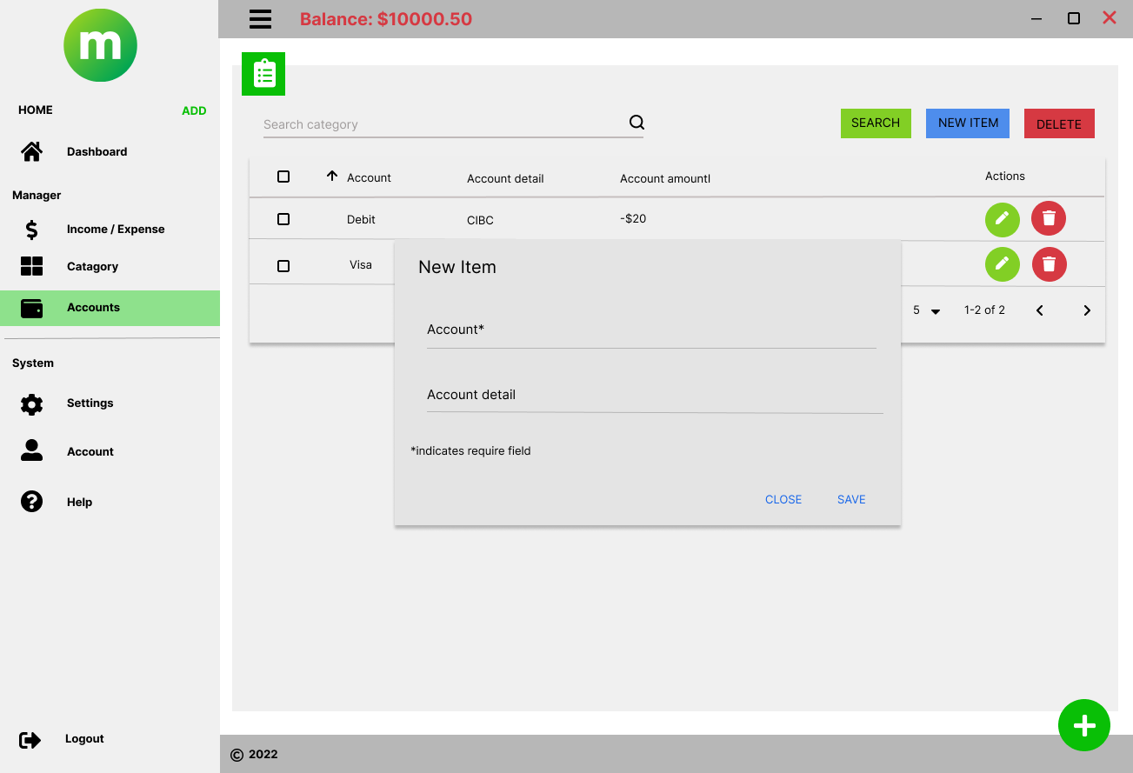
Manager – accounts – adding new account

Slide 24
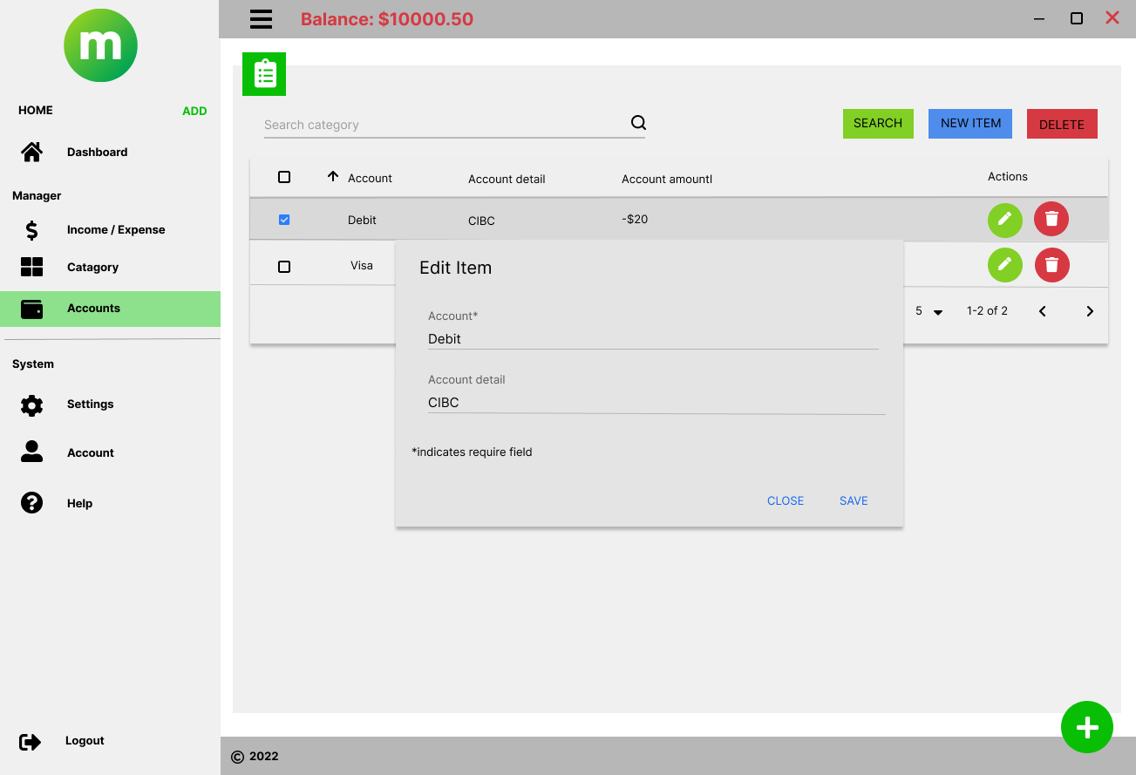
Manager – accounts – editing

Slide 25
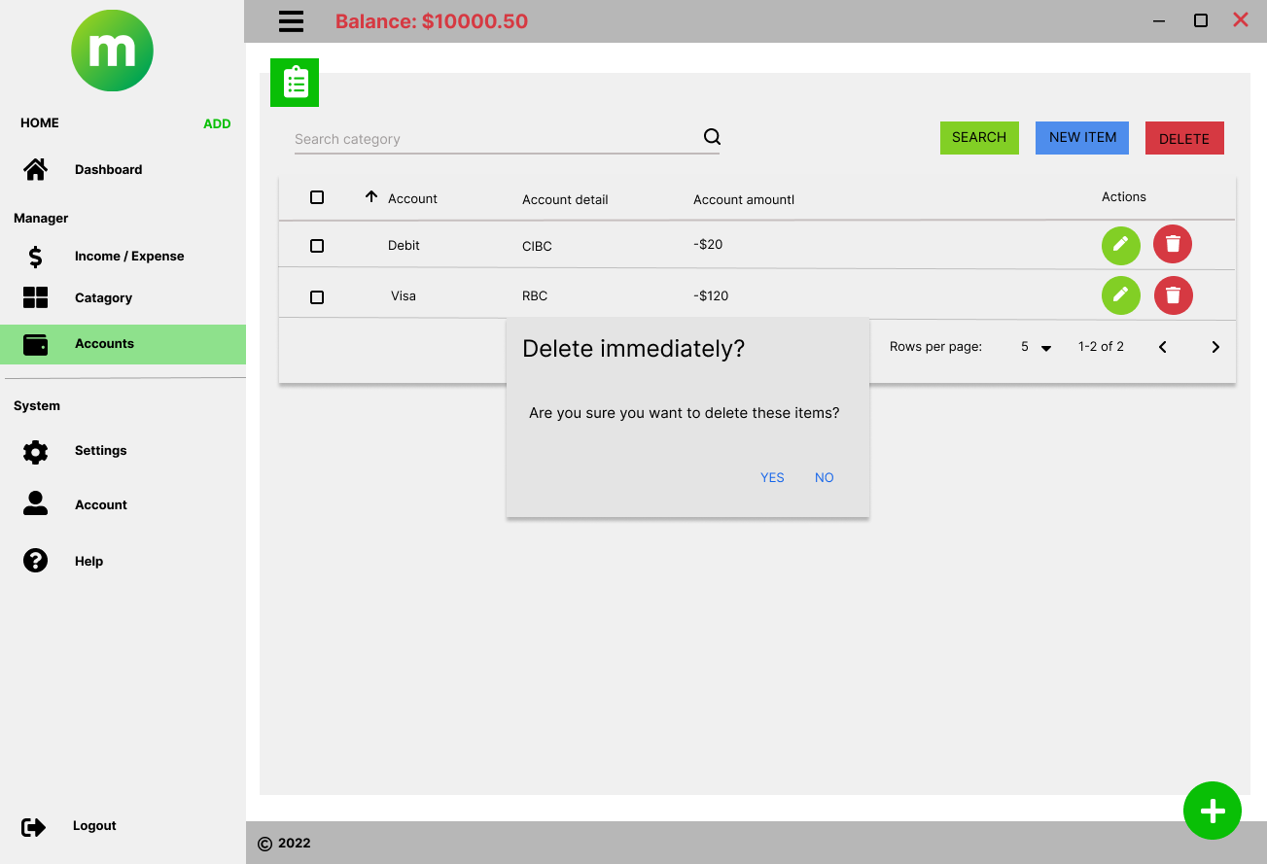
Manager – accounts – delete account

Slide 26
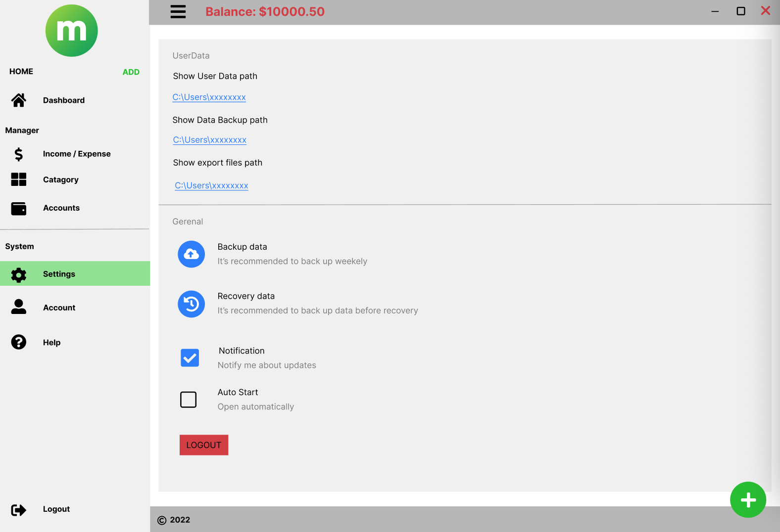
System - settings

Slide 27
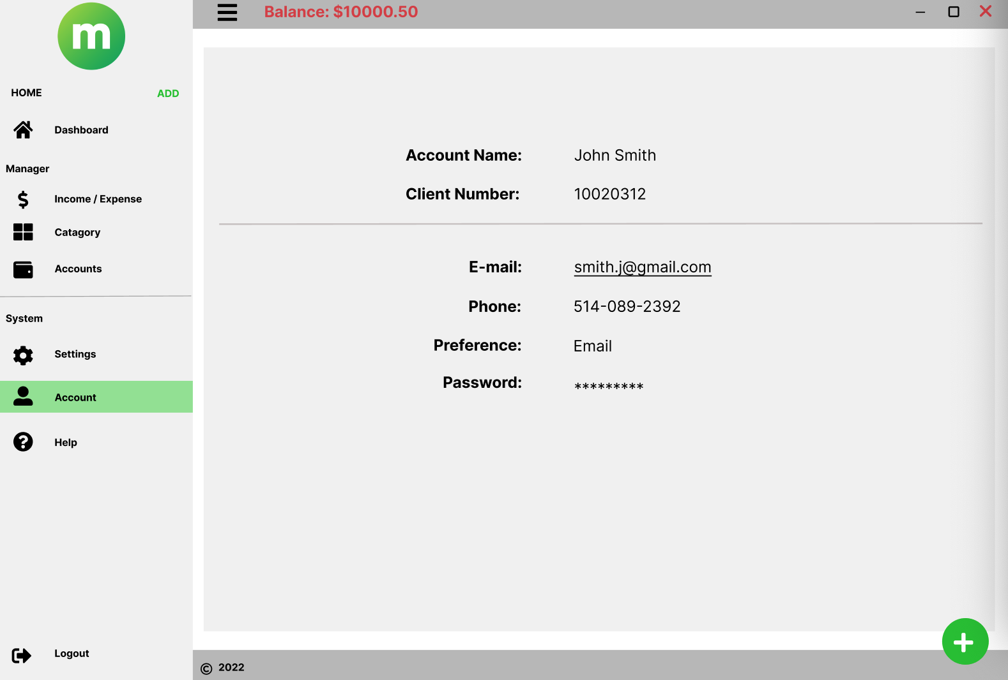
System - account

Slide 28
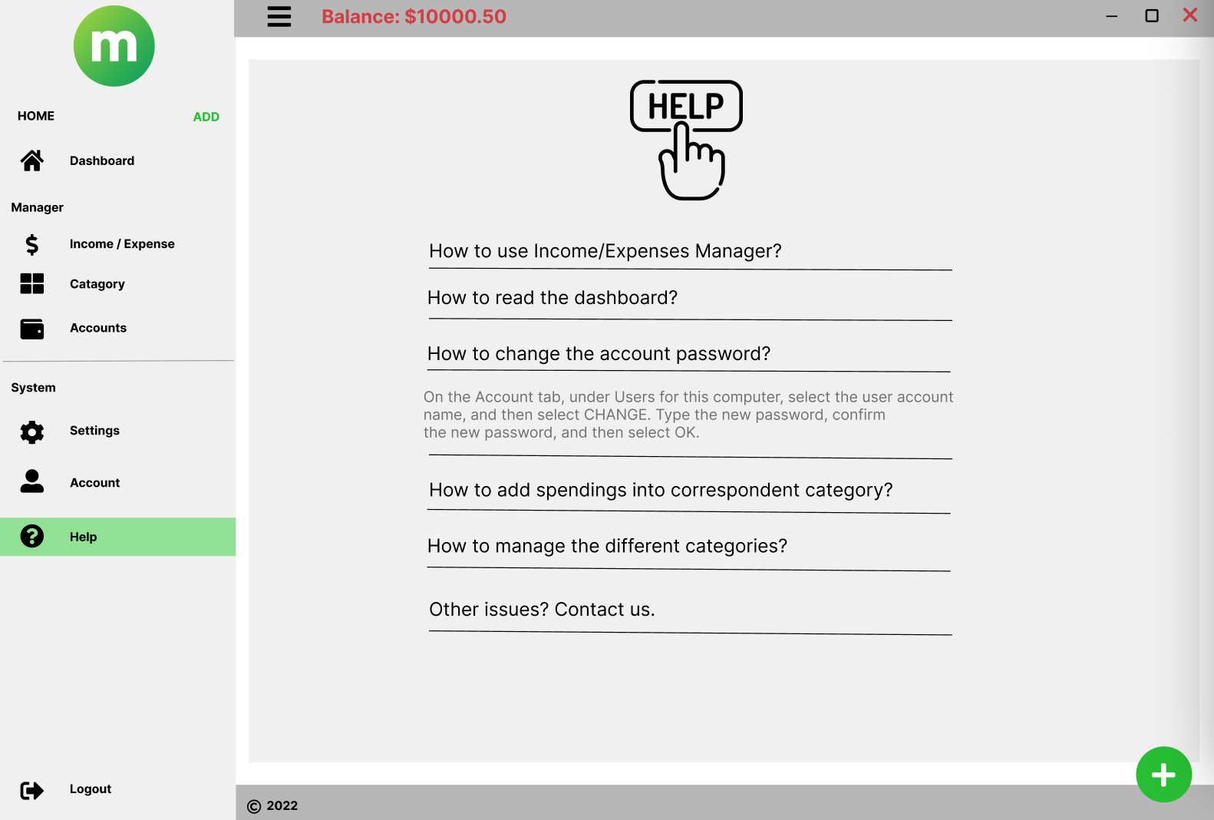
System - help

Slide 29
Log out

Slide 30
Thank you

